Slide 1
Effectiveness of Customer Support Interactions on Twitter
Presentation By:
Abhaya Shukla
Dhruv Toshniwal
Rohan Sawant

Slide 2
Research Question
How effective are customer support interactions on Twitter, and what patterns of communication lead to successful resolutions

Slide 3
Dataset
The chosen dataset is from Kaggle, titled "Customer Support on Twitter." It contains over three million tweets and replies from some of the most prominent brands on Twitter. The dataset includes variables such as tweet ID, author ID, creation time, text of the tweet, and related response IDs. This dataset is suitable because it offers a comprehensive view of customer-brand interactions, allowing for a detailed analysis of support effectiveness, user engagement patterns, and communication styles.
Dataset Link: https://www.kaggle.com/datasets/thoughtvector/customer-support-on-twitter

Slide 4
Methods
Analysis of average response time and average response length
N-grams to find common themes in user engagement
Link analysis
Language and text patterns using TextBlob
Sentiment change for follow up tweets
Latent Dirichlet Allocation(LDA)

Slide 5
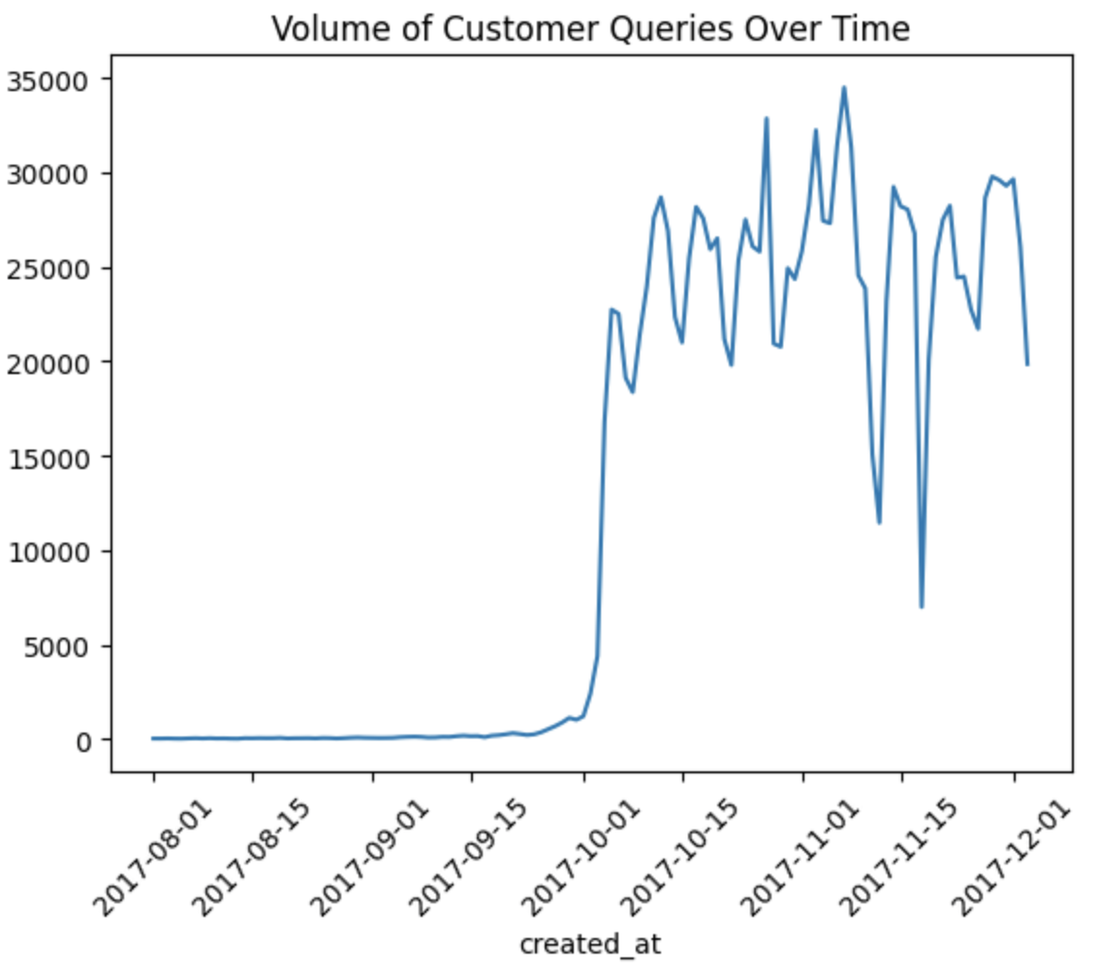
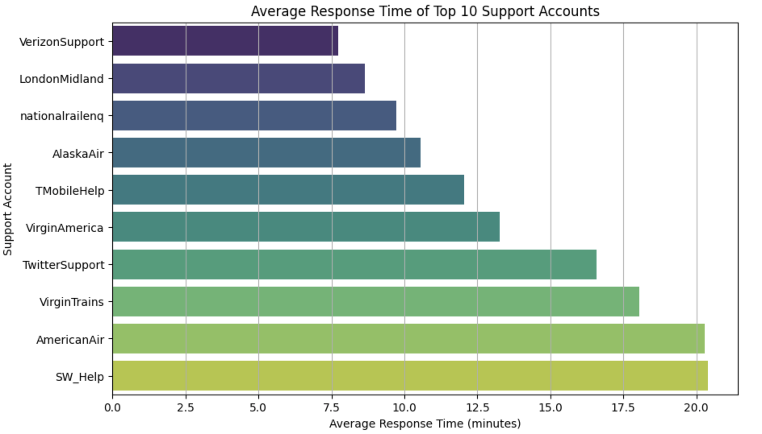
Findings and Visualizations

Slide 6
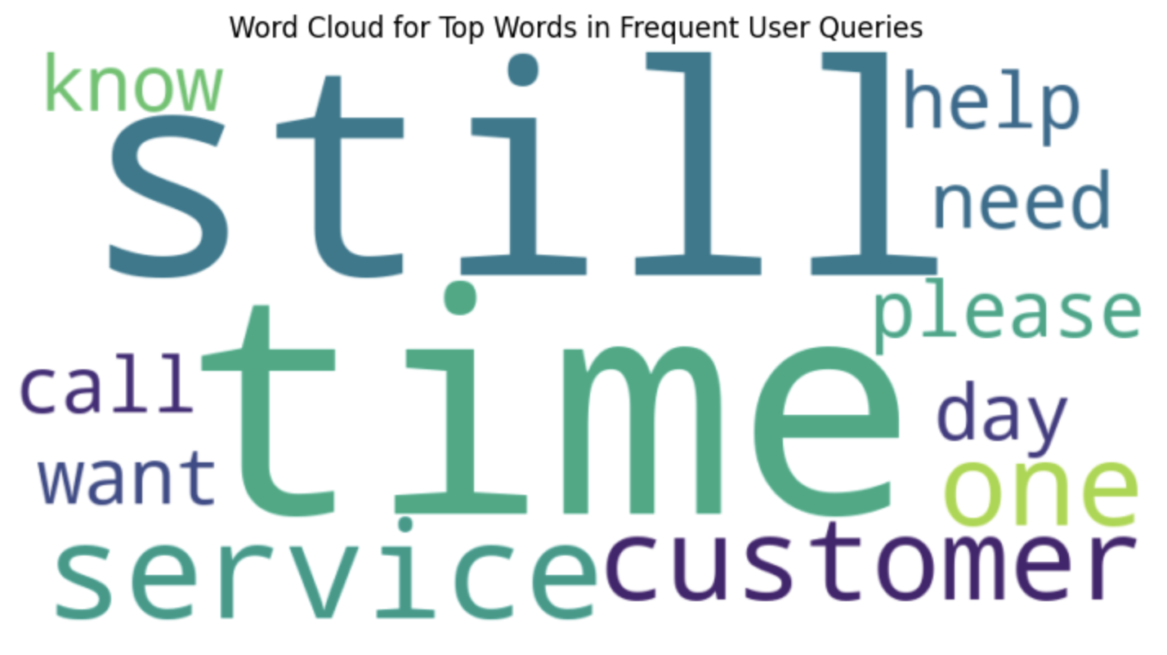
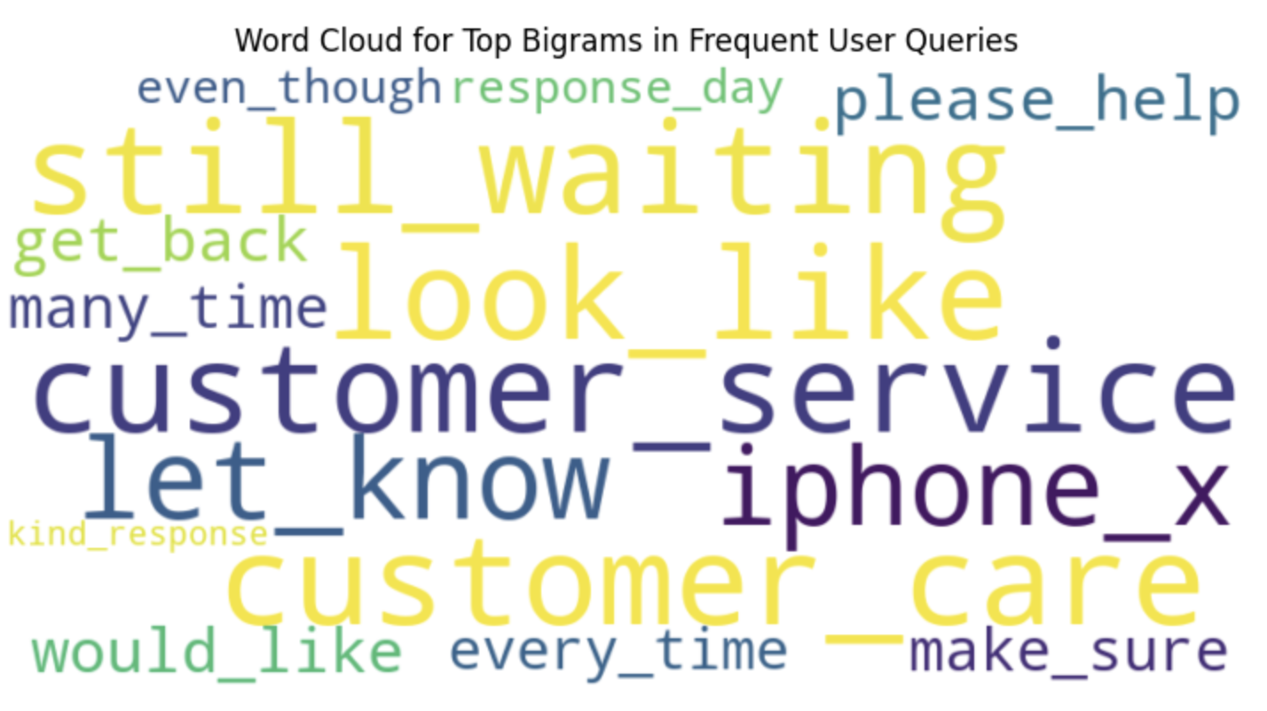
Findings and Visualization

Slide 7
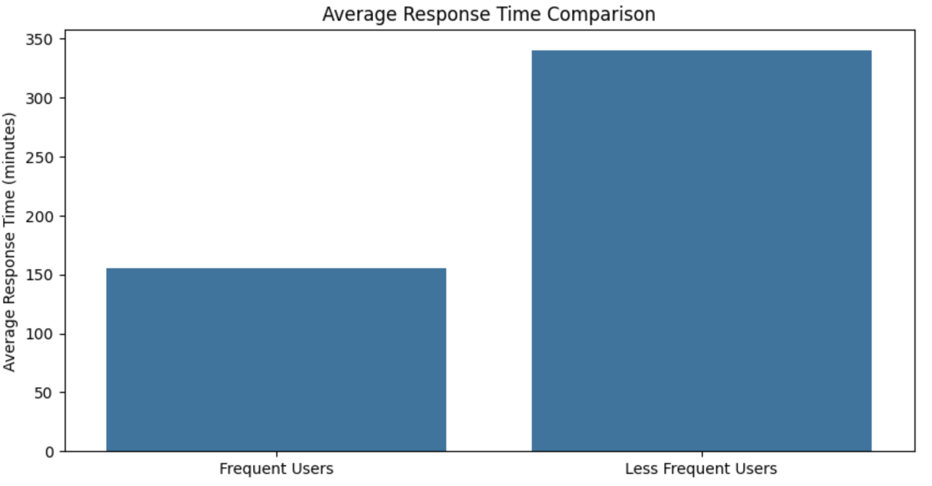
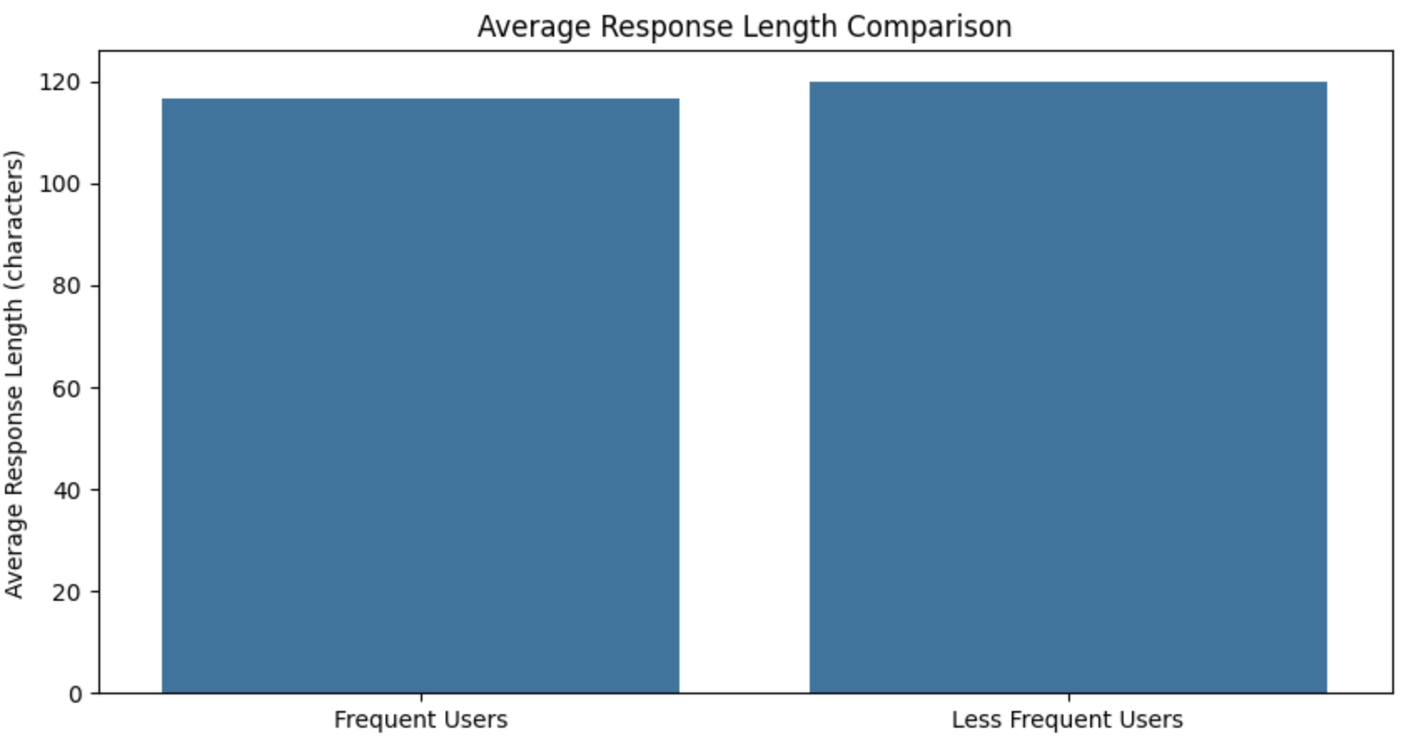
Findings and Visualization

Slide 8
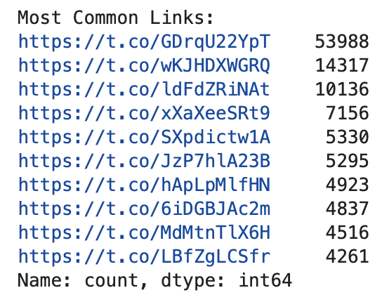
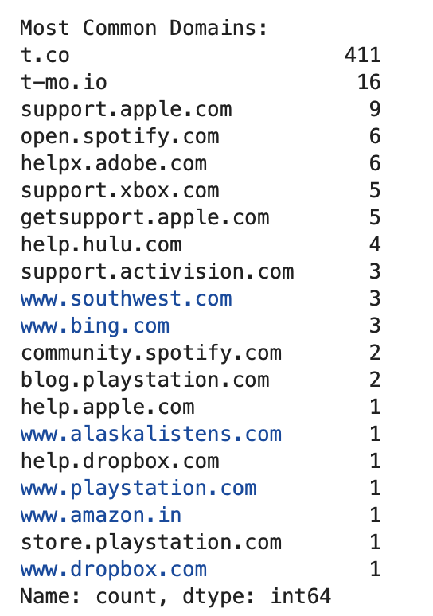
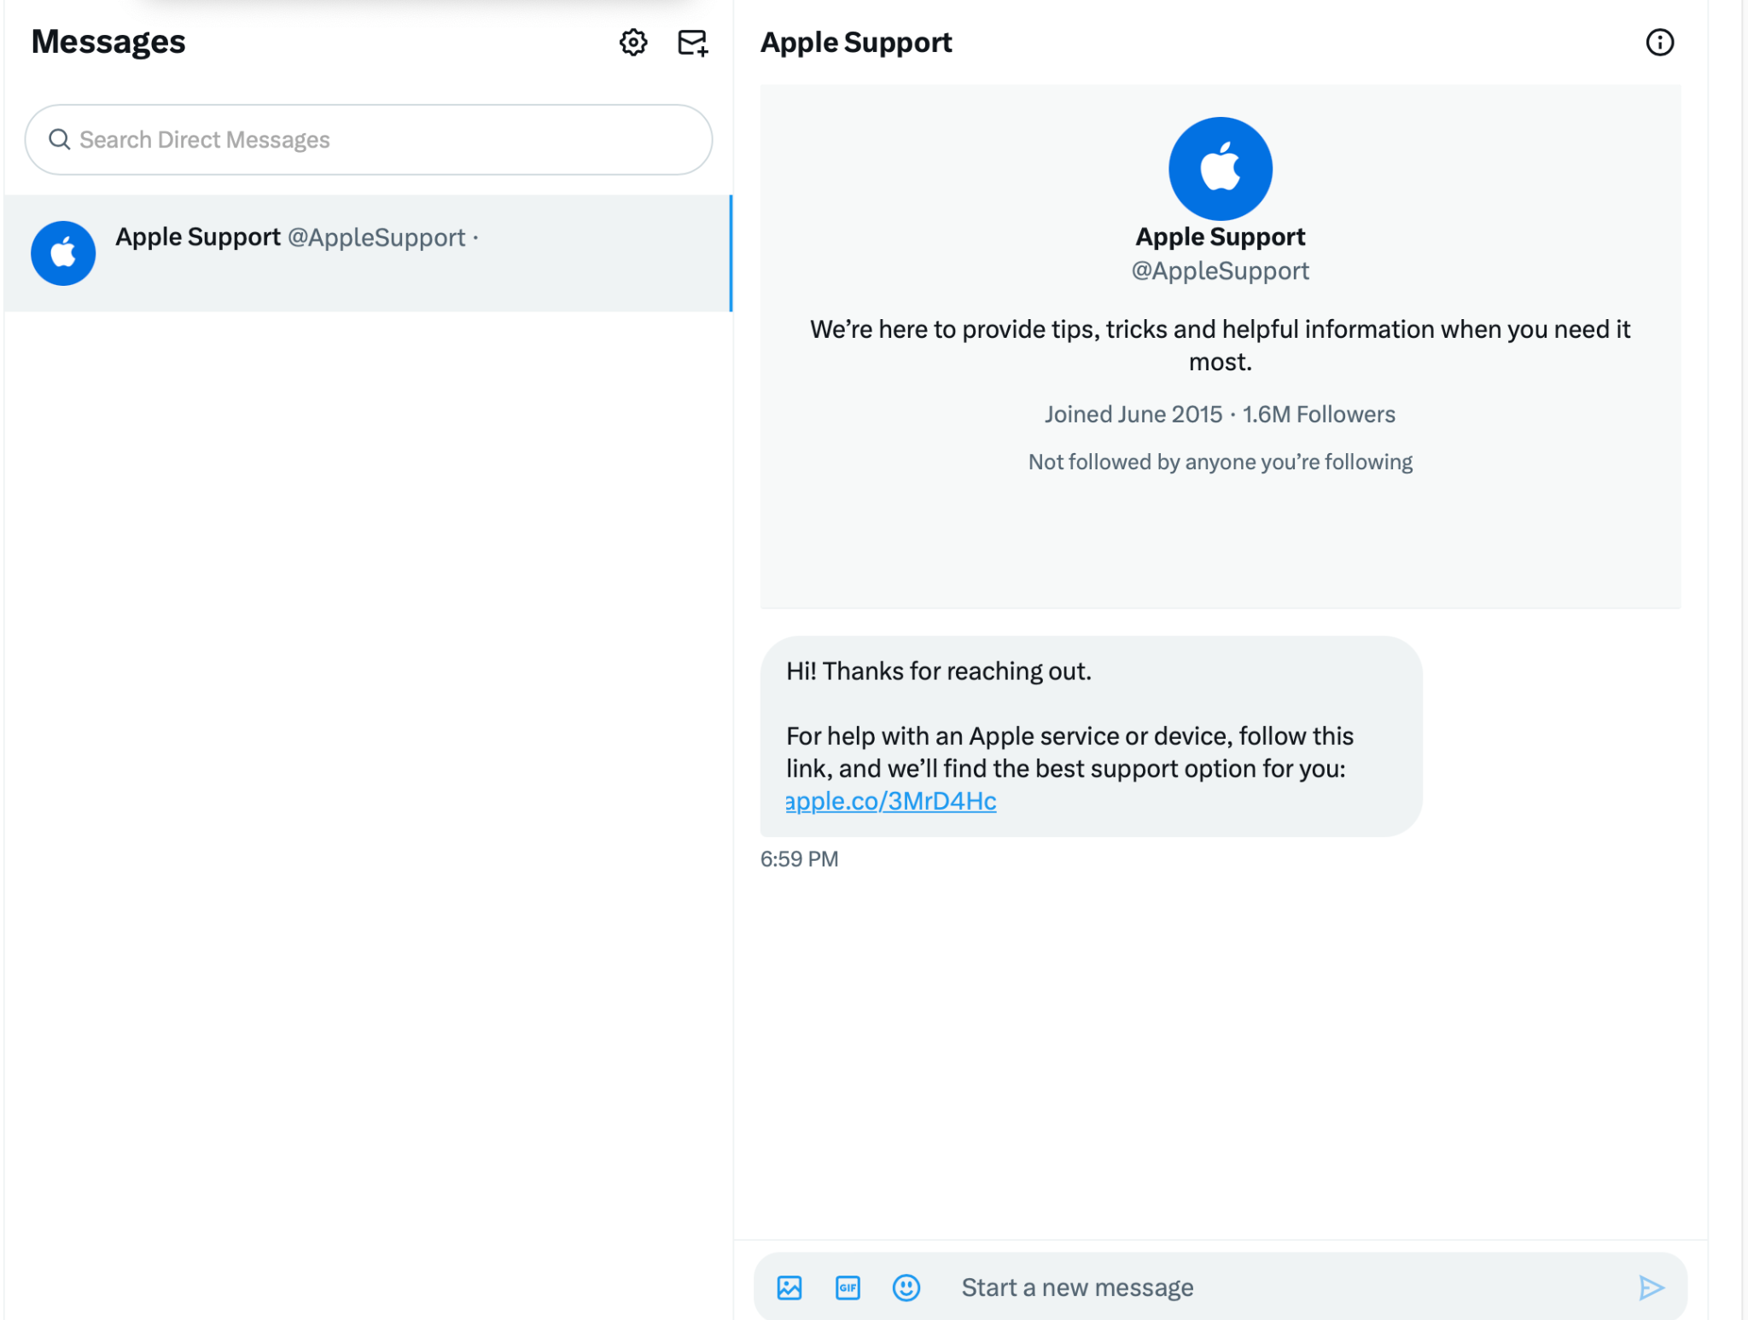
Link Analysis

Slide 9
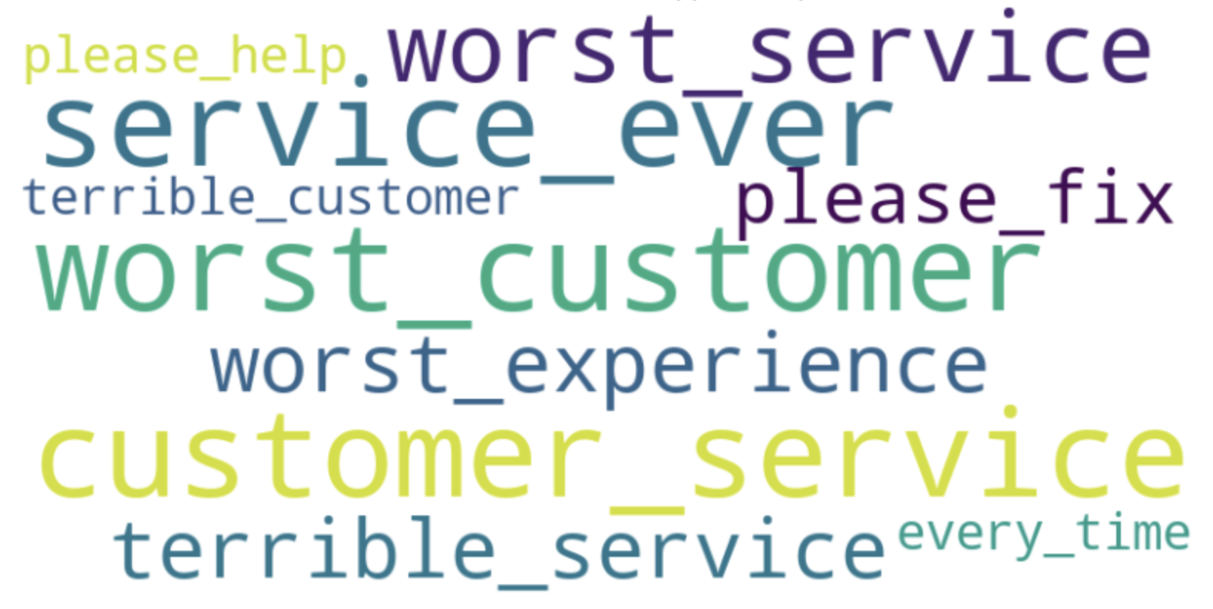
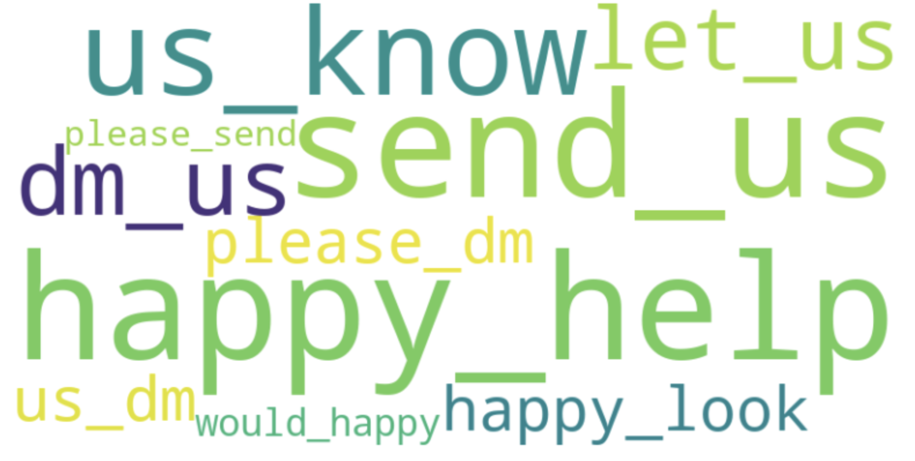
Language and text patterns using TextBlob

Slide 10
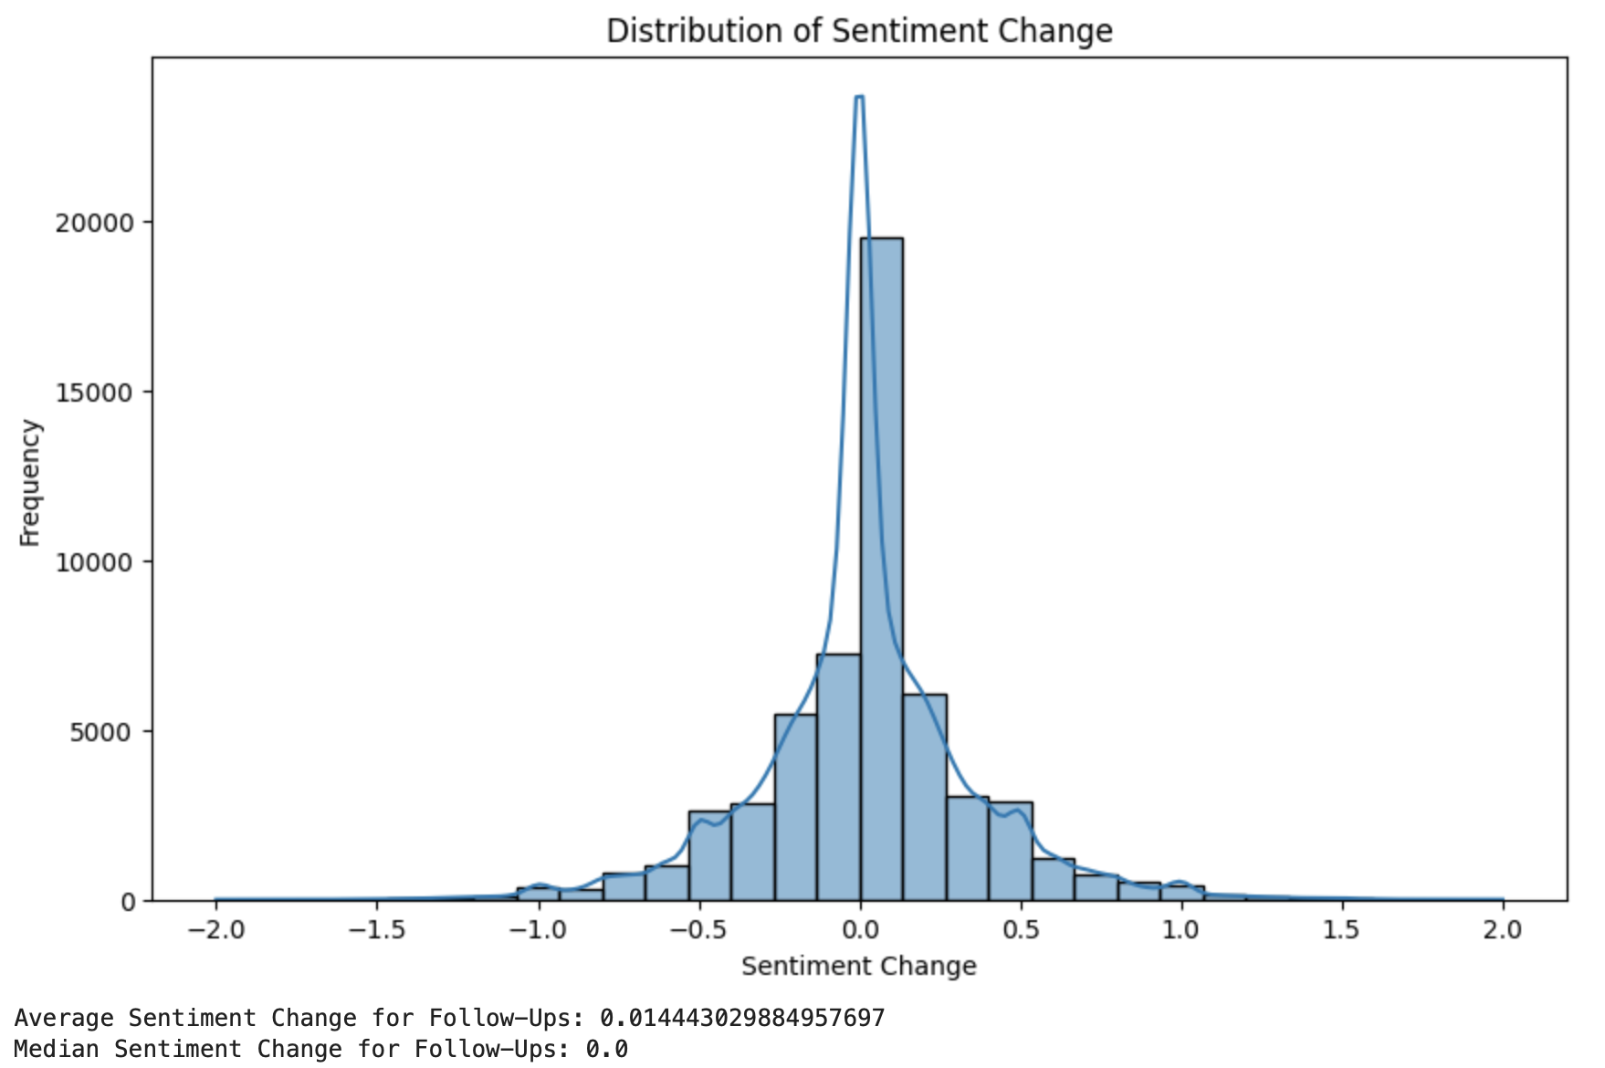
Sentiment Change

Slide 11
Latent Dirichlet Allocation
LDA is an unsupervised topic model that discerns hidden themes in textual data.
It assumes each document is a mix of topics; each topic is a blend of words.
Used to categorize documents in recommender systems and as NLP preprocessing.
Benefits from unsupervised learning, scaling well with large datasets.
Challenges include determining the right number of topics and the subjective nature of topic interpretation.

Slide 12
Limitations
Dataset Scope: The dataset primarily focuses on major brands, possibly overlooking smaller ones or certain time periods, leading to potential bias.
Metric Selection: Reliance on response time and follow-up frequency as key metrics may not fully capture overall user satisfaction or resolution quality.
Sentiment Analysis Limitations: Tools like TextBlob, while effective, may not accurately interpret complex sentiments, such as sarcasm or cultural nuances.
External Factors Overlooked: The dataset may not consider external influences (product launches, PR challenges, global events), affecting tweet volume and sentiment.

Slide 13
Conclusion
Sentiment Trends: The sentiment change histogram indicates a general maintenance of user sentiment post-interaction, with a slight overall shift towards positivity. This suggests that while support responses are balanced, they tend to slightly improve user sentiment.
Response Time Insights: Frequent users experience shorter average response times compared to less frequent users, highlighting efficient support for regular interactors.
A moderate coherence score (0.3888) from the LDA model suggests reasonable interpretability of topics, indicating room for further refinement.
Analysis reveals diverse topics from air travel to customer service, including a notable focus on technical support and frequent URL sharing in tweets for information and promotion.

